Slide 1
Software QA Process

Slide 2
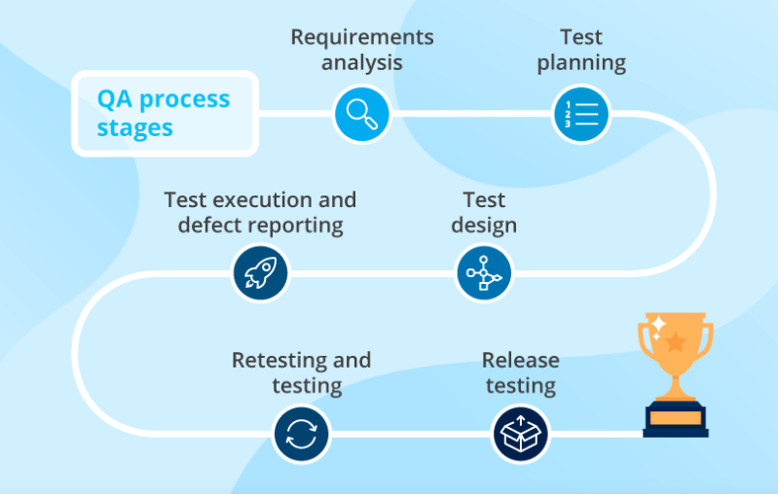
Quality Assurance Process Stages
Software quality assurance should start as early in the software development life cycle as at the requirements gathering stage and comprise the following activities:

Slide 3
Requirements analysis
The cost of fixing a defect found during testing is up to 15 times higher than the cost of preventing one at the requirements design stage. To avoid that, QA professionals are involved in the analysis and clarification of functional and non-functional software requirements and make sure the requirements are clear, consistent, complete, traceable, and testable. Thus, they prevent possible software defects and facilitate upcoming test design activities.

Slide 4
Test planning
QA professionals use the knowledge gained at the requirements analysis stage as a basis for test planning. According to IEEE 29119-3, a test plan should contain a test strategy and cover a testing scope, a project budget and deadlines, the types and levels of testing an application requires, bug tracking and reporting procedures, resources and their responsibilities, and other factors.

Slide 5
Test design
At this stage, QA specialists design test cases or checklists covering software requirements. Test cases outline conditions, test data (prepared at the test design stage as well), and test steps needed to validate particular functionality, and state an expected test result. In order to gain familiarity with an application and come up with an optimal approach to test design, test engineers may start test design activities with a certain amount of exploratory testing.

Slide 6
Test execution and defect reporting
Test execution starts at the unit level, when the development team performs unit testing. In its turn, the test team takes over at the API and UI levels. Manual test engineers execute the designed test cases, submitting found defects in a defect tracking system, while test automation engineers use a selected framework (e.g., Selenium, Appium, Protractor) to execute automated test scripts and generate test reports.

Slide 7
Retesting and regression testing
Once the found defects are fixed, test engineers retest functionality in question and perform regression testing to make sure that bug fixes neither broke the related functionality nor made it different from that specified in the requirements.

Slide 8
Release testing
Once the development team issues a release notification (containing the list of implemented features, fixed defects, known issues and limitations), the test team identifies software functionality that has been affected by the introduced changes and determines test suites required to cover the scope of the deployed build. The test team performs smoke testing to make sure the build is stable and, once it is successfully passed, executes the identified test suites, issuing a test result report when finished.

Slide 9
QA process setup
To set up an efficient QA process for product and enterprise software, a QA consultant from an internal testing center of excellence (TCoE) or a QA outsourcing provider should consistently take the following steps:
Audit the existing QA process
Design a new QA process
Implement a new QA process
Monitor the effectiveness of the introduced changes

